Slide 1
OSU CSE5911: FlowTrack
Business Meeting
October 3rd 17:00

Slide 2
Table of Contents
Gantt Chart
Current Progress
Business View
Technical View
Future Plan
Before First Demo Day
After First Demo Day
Discussion

Slide 3
Gantt Chart
Sprint 1: 9.3-10.15

Slide 4
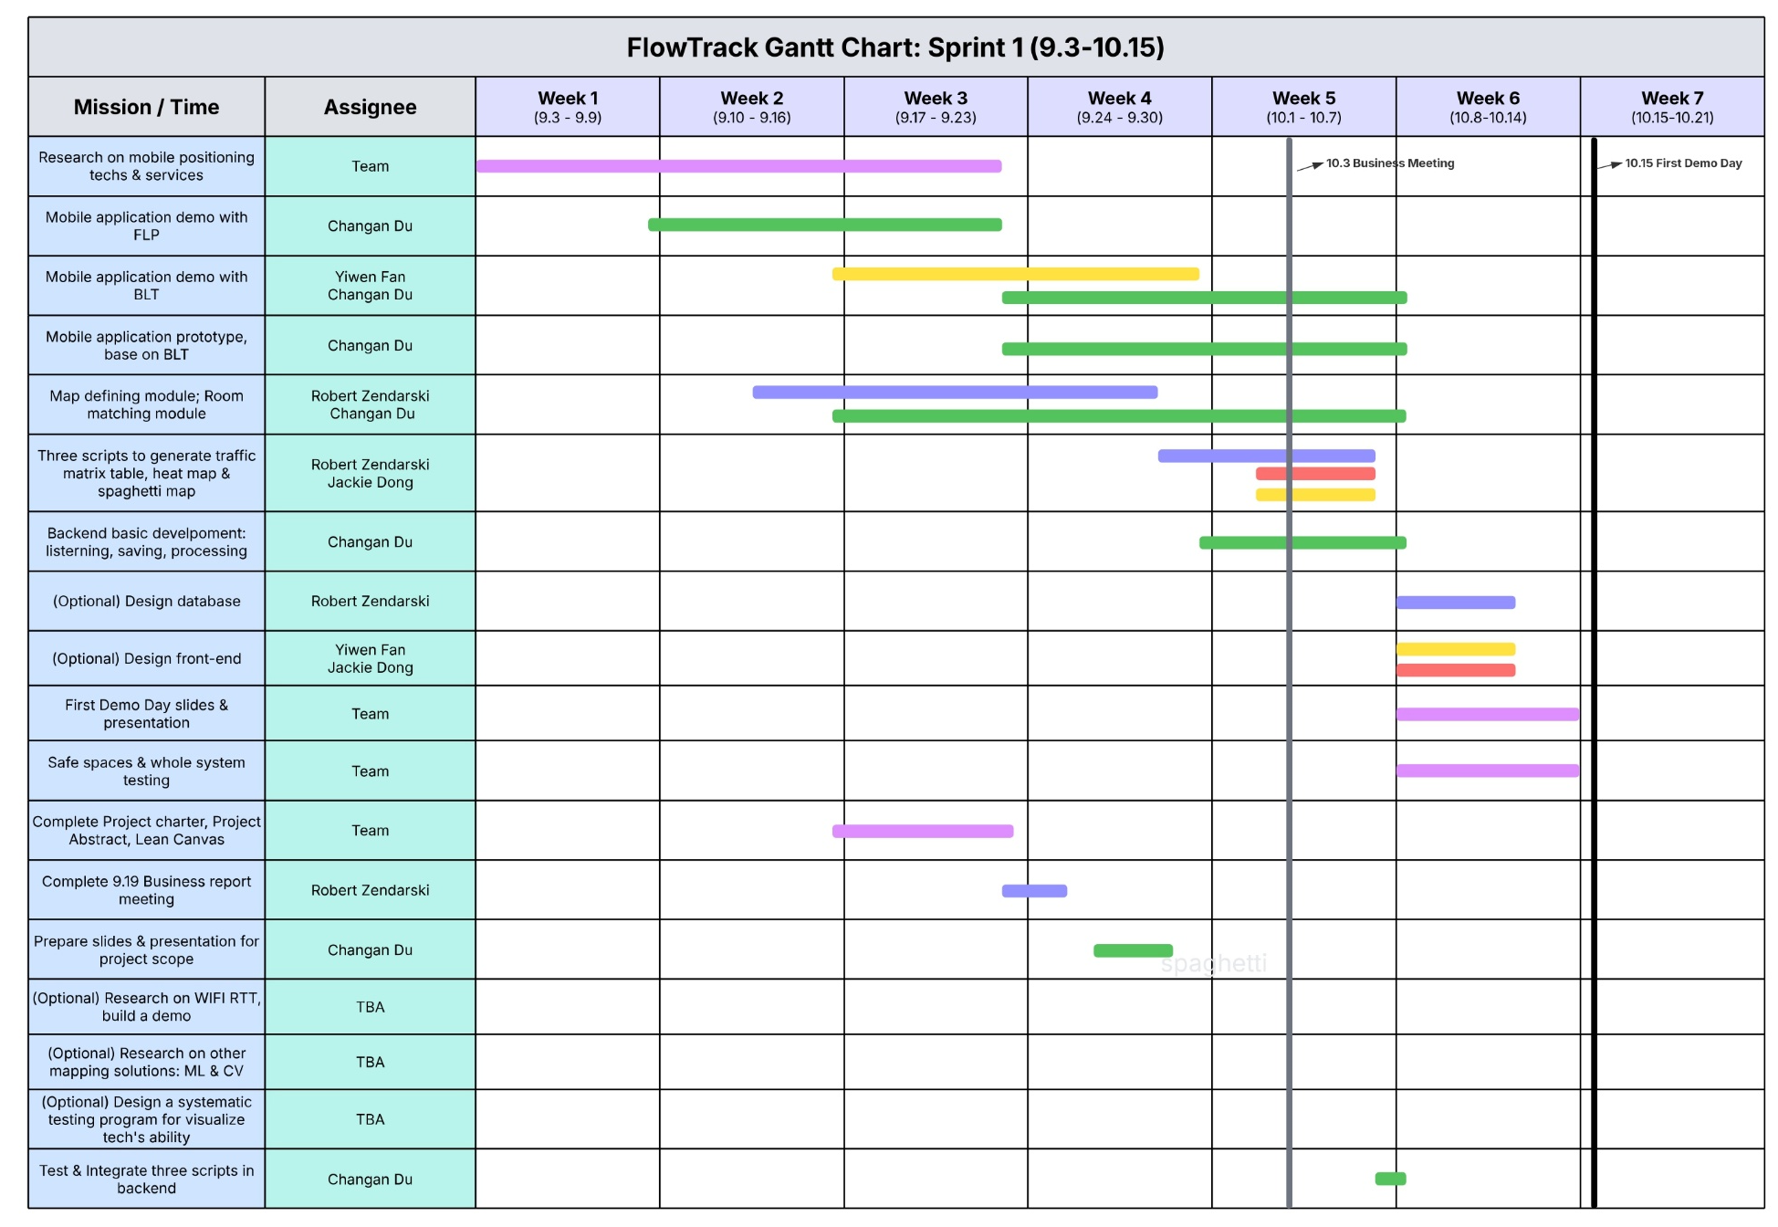
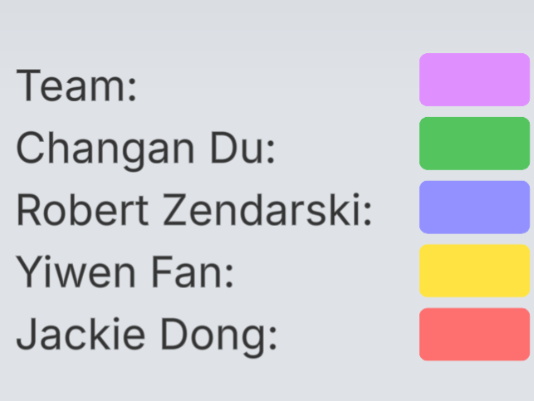

Slide 5
Current Progress
Business View

Slide 6
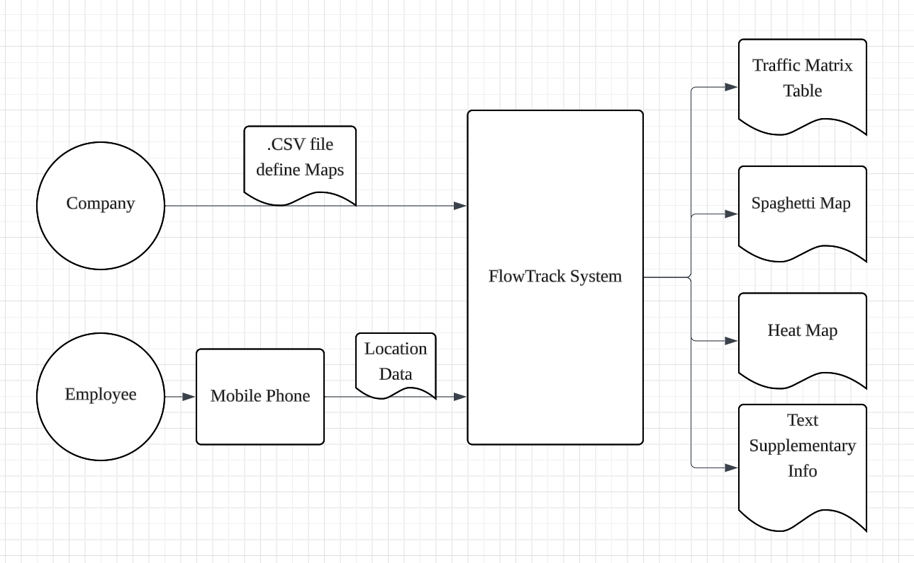
Flow Chat on Business side
Explanation & Clarification on:
.csv Map document
Traffic Matrix Table
Spaghetti Map
Heat Map

Slide 7
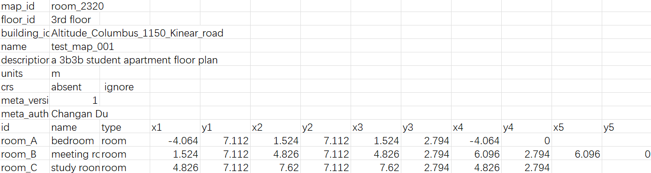
1. .csv Map Document
Why need it?
to calculate relative position and generate visualization report
customer themselves define the map, set diff area/rooms…
What inside it?

Slide 8
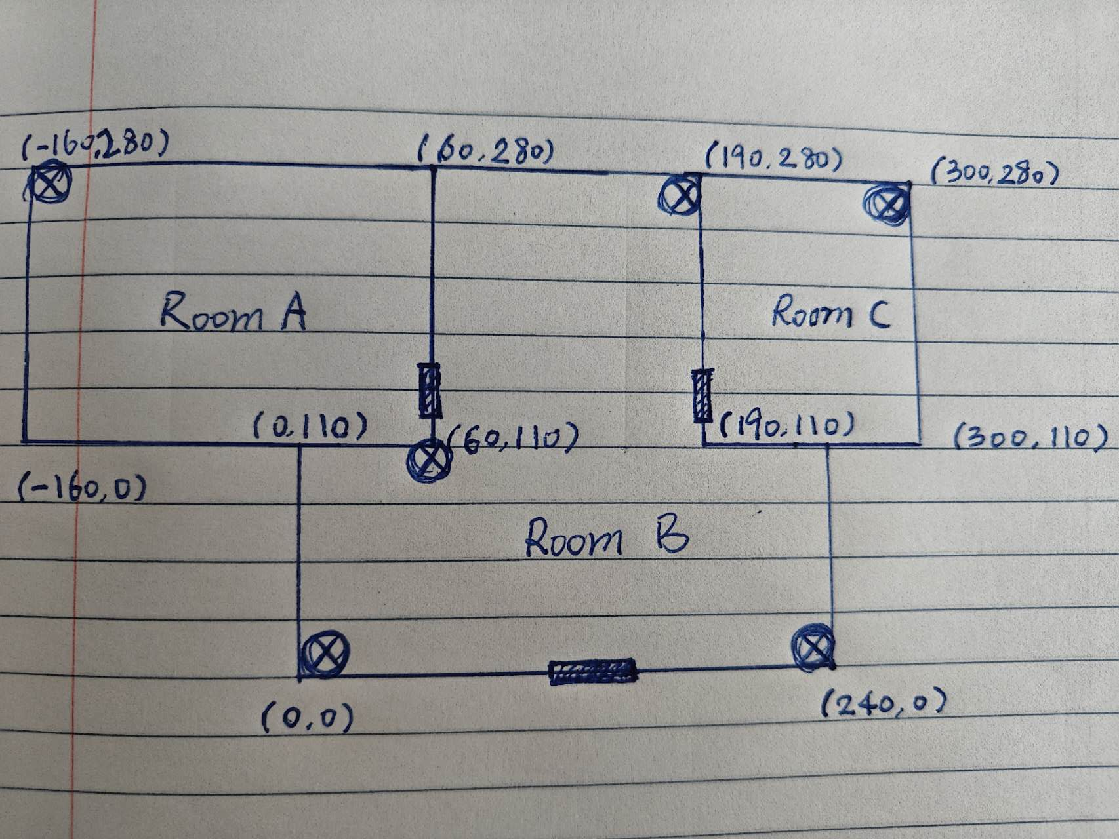
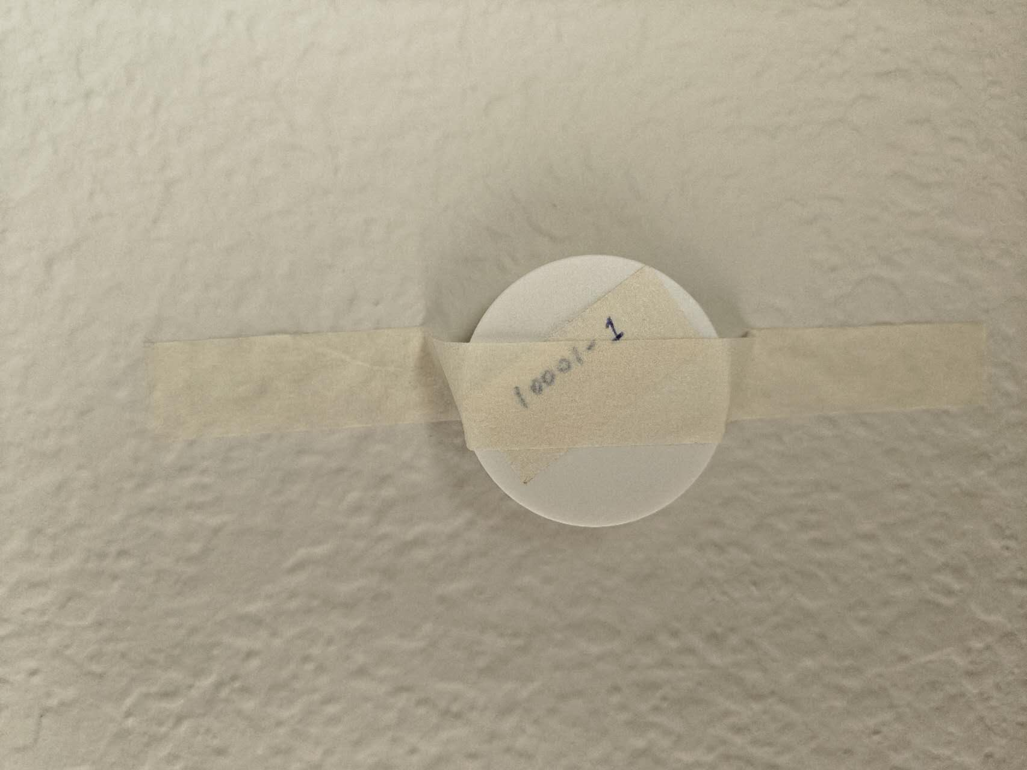
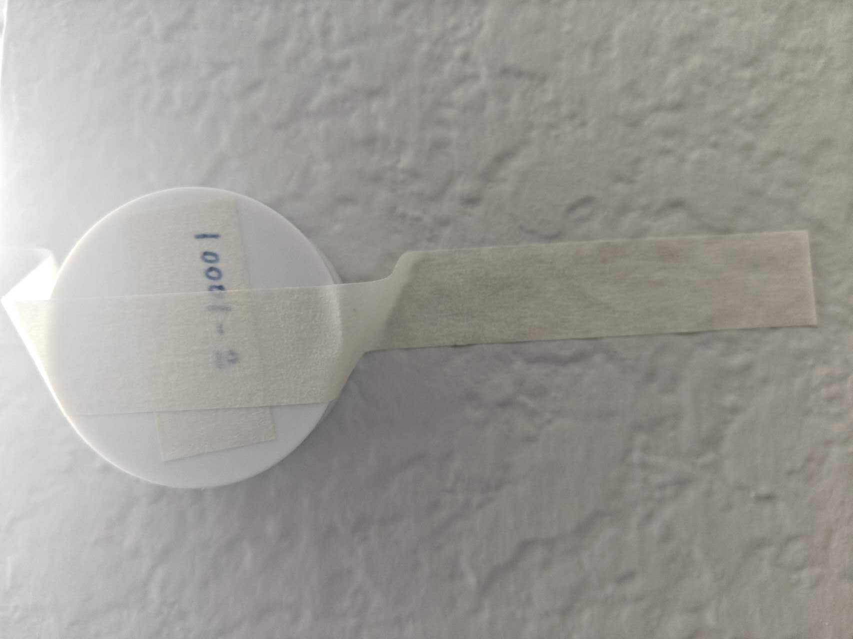
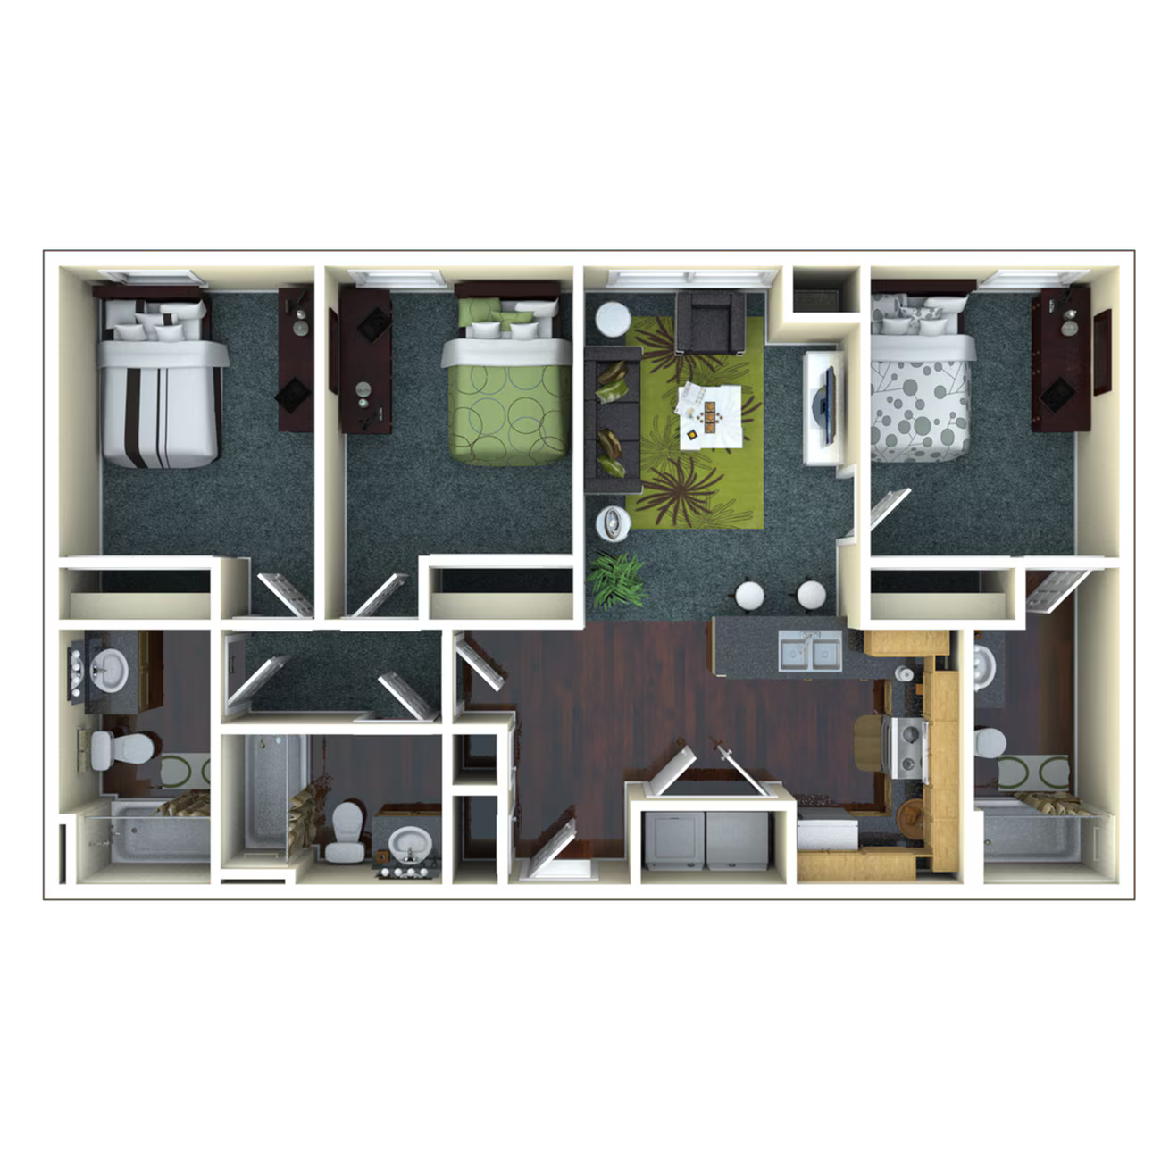
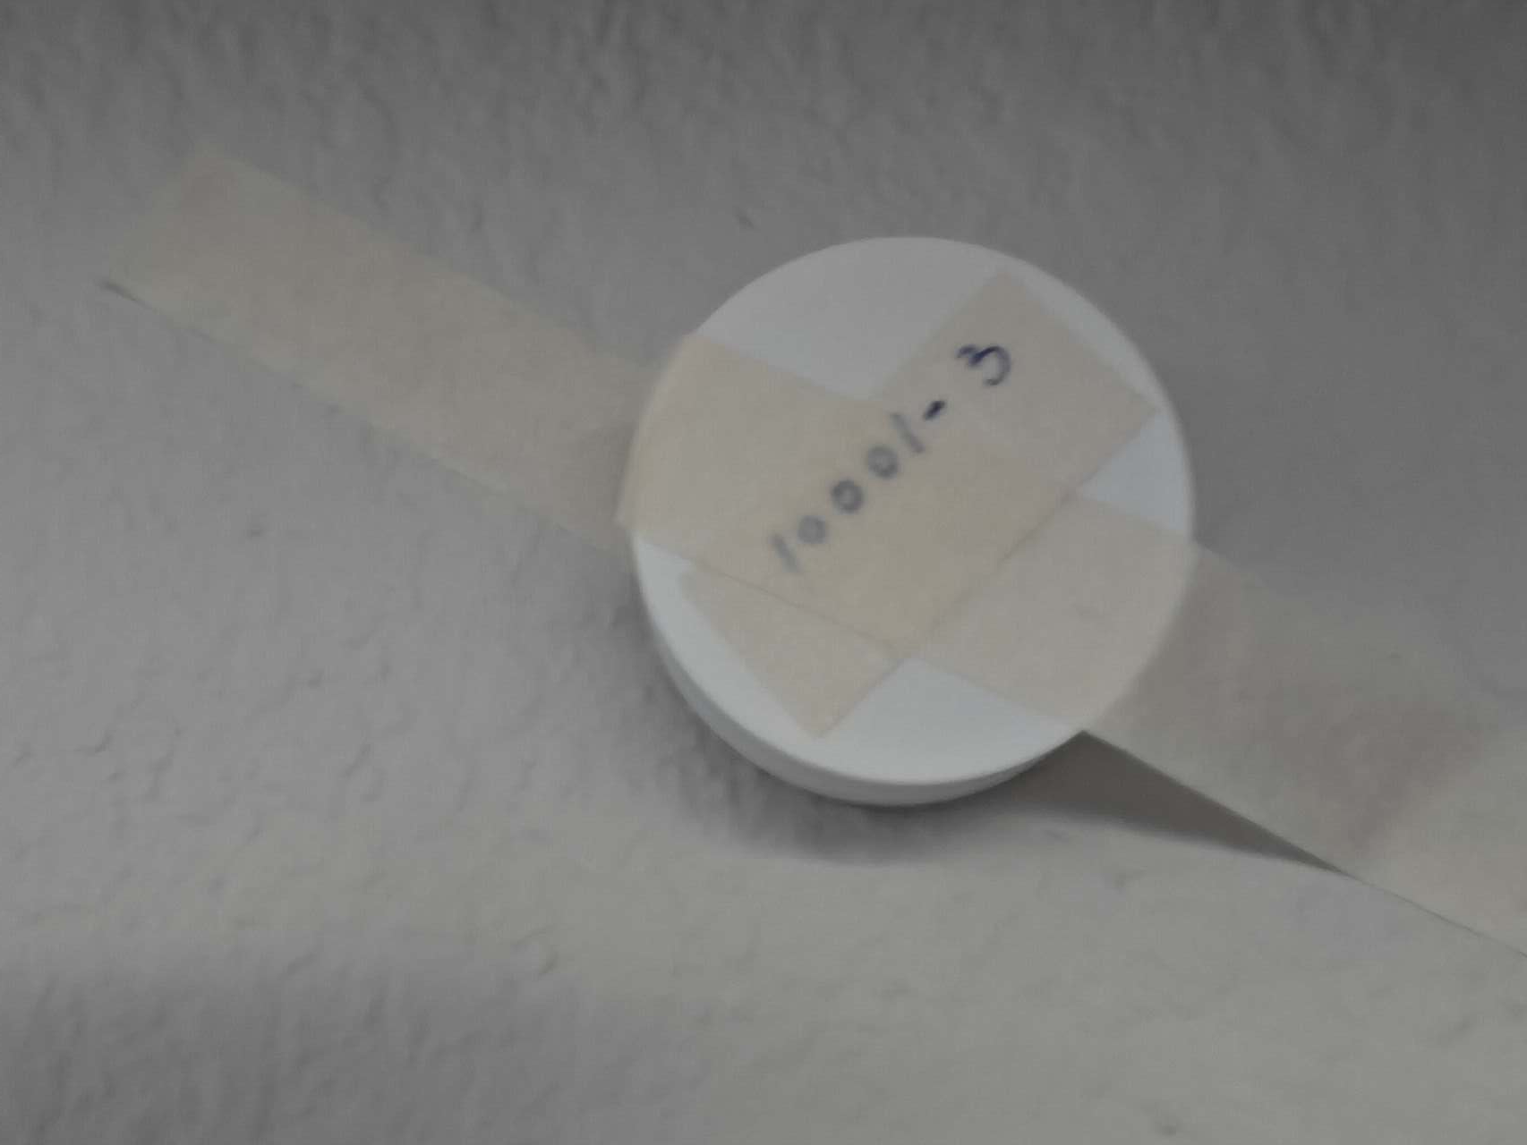
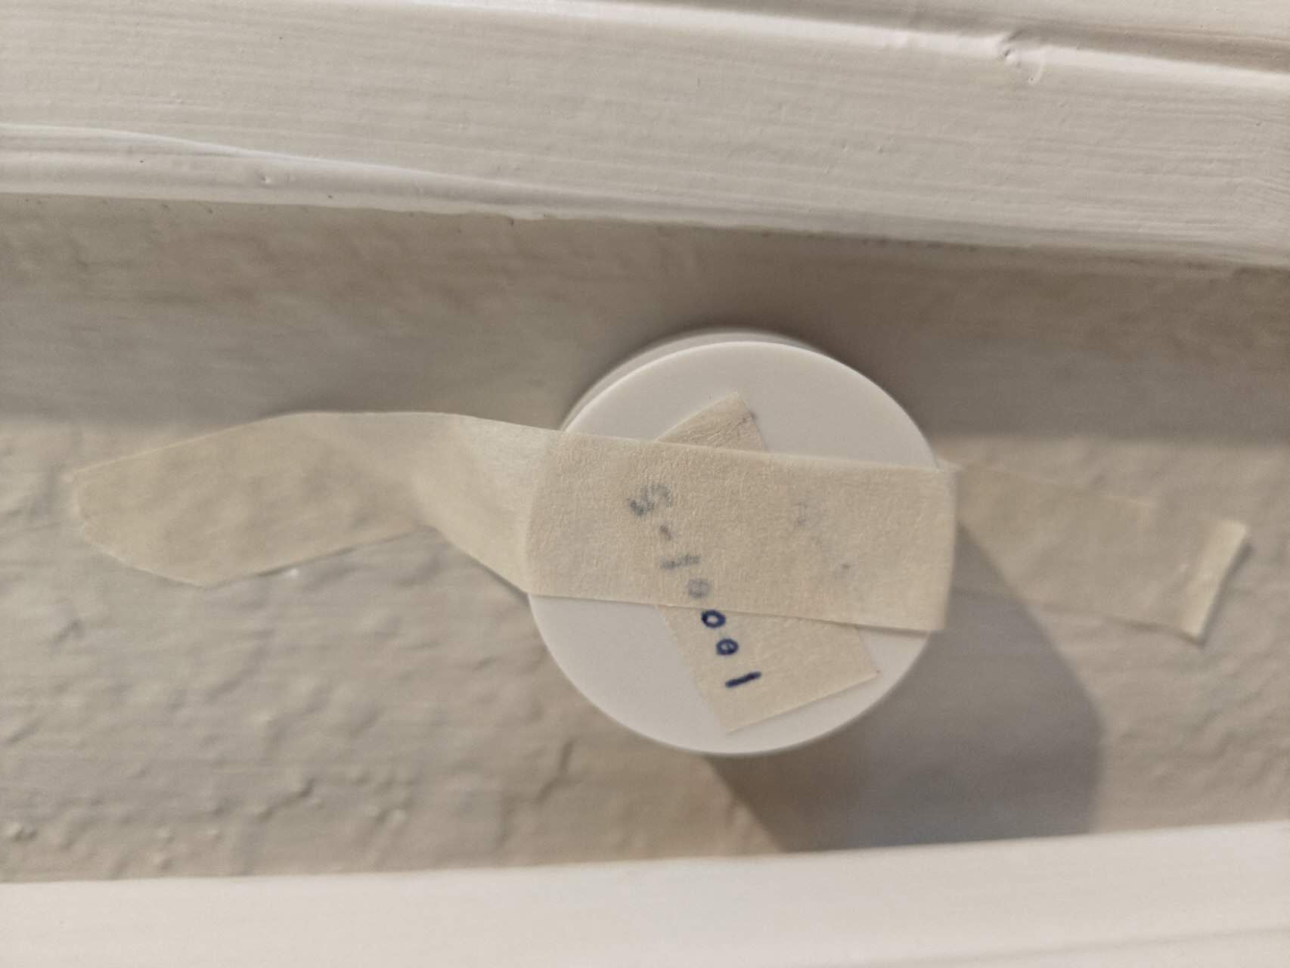
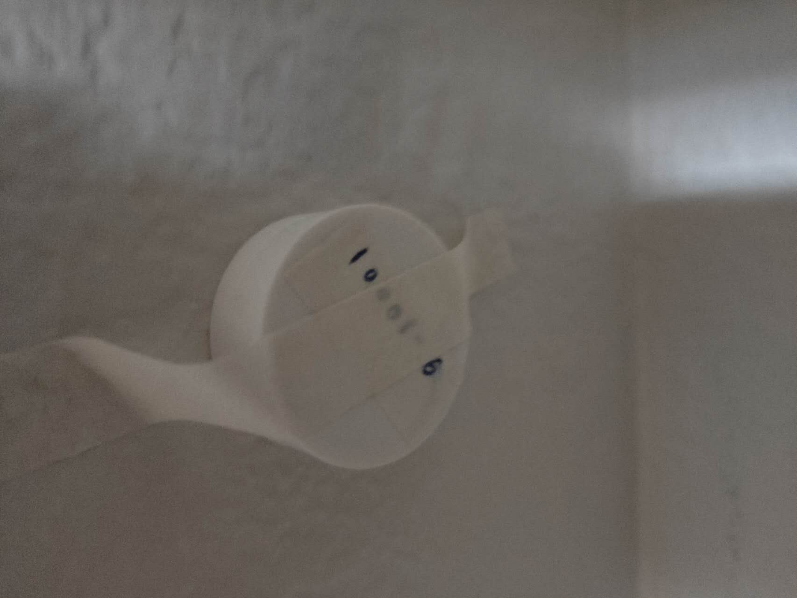
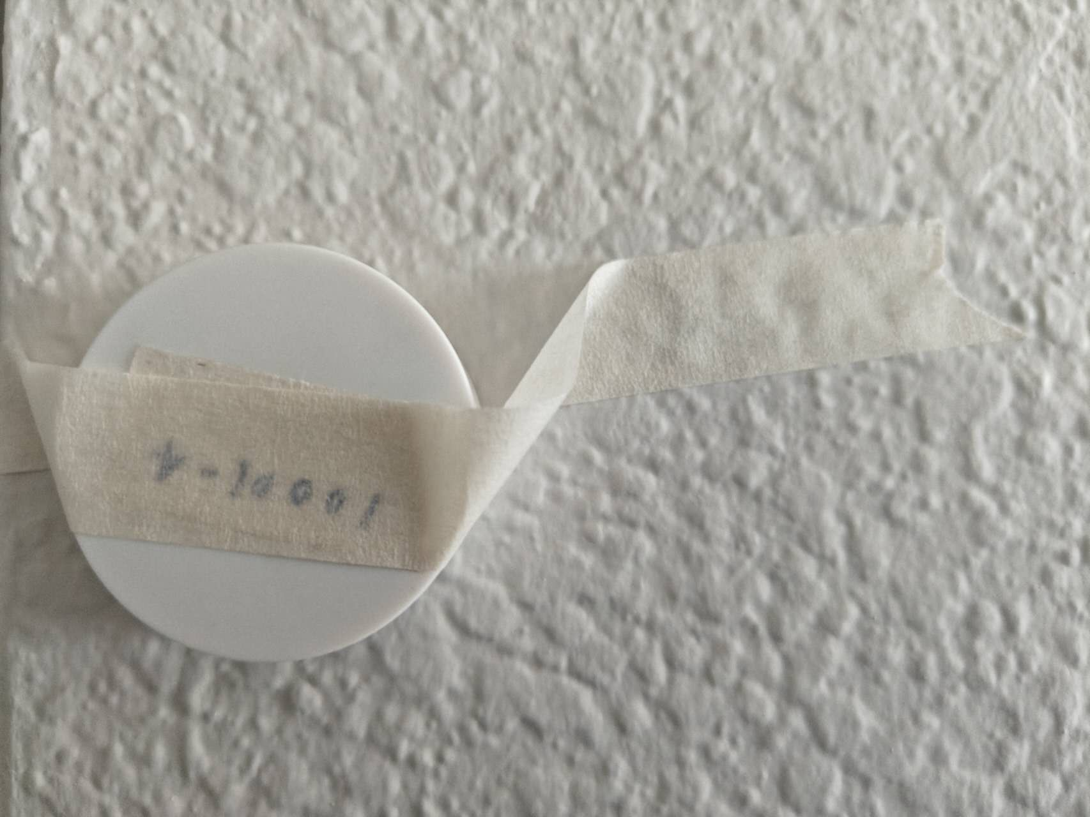
1. .csv Map Document
How to make it?
I pretended to be from the company, created a map, and used it for the subsequent positioning test.

Slide 9
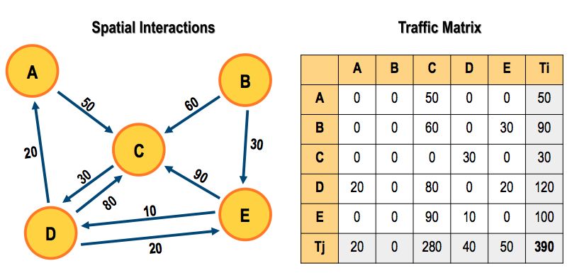
2. Traffic Matrix Table

Slide 10
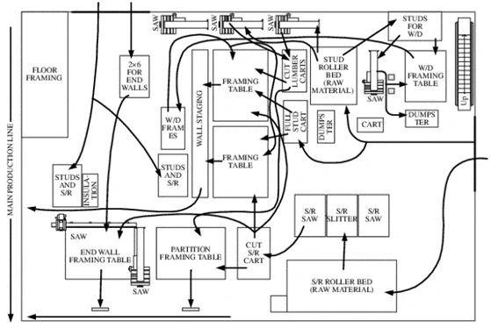
3. Spaghetti Map

Slide 11
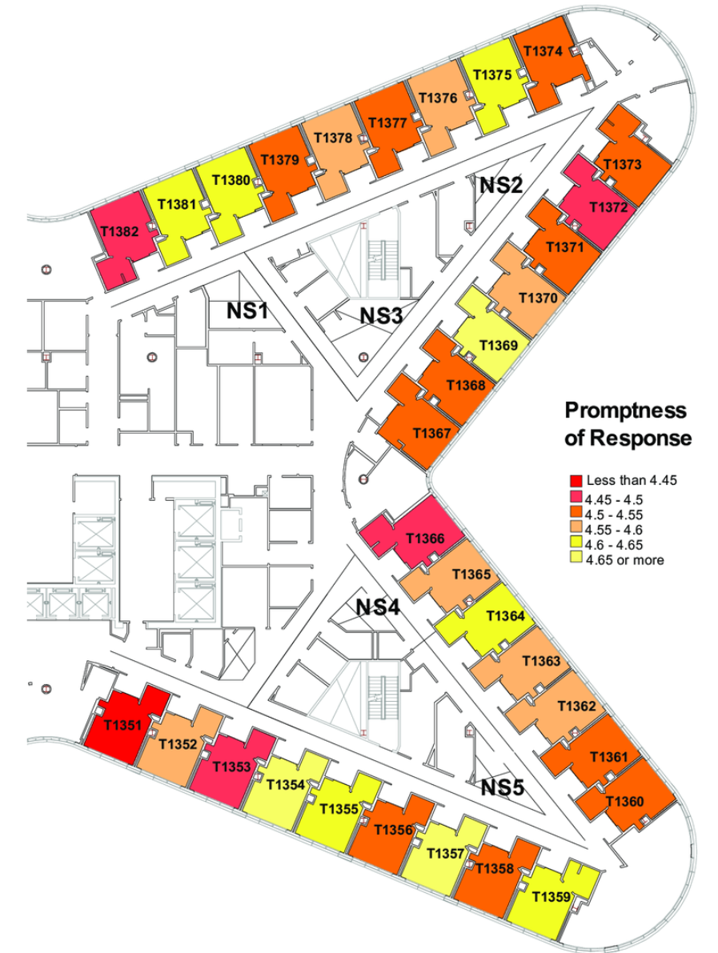
4. Heat Map

Slide 12
Current Progress
Technical View

Slide 13
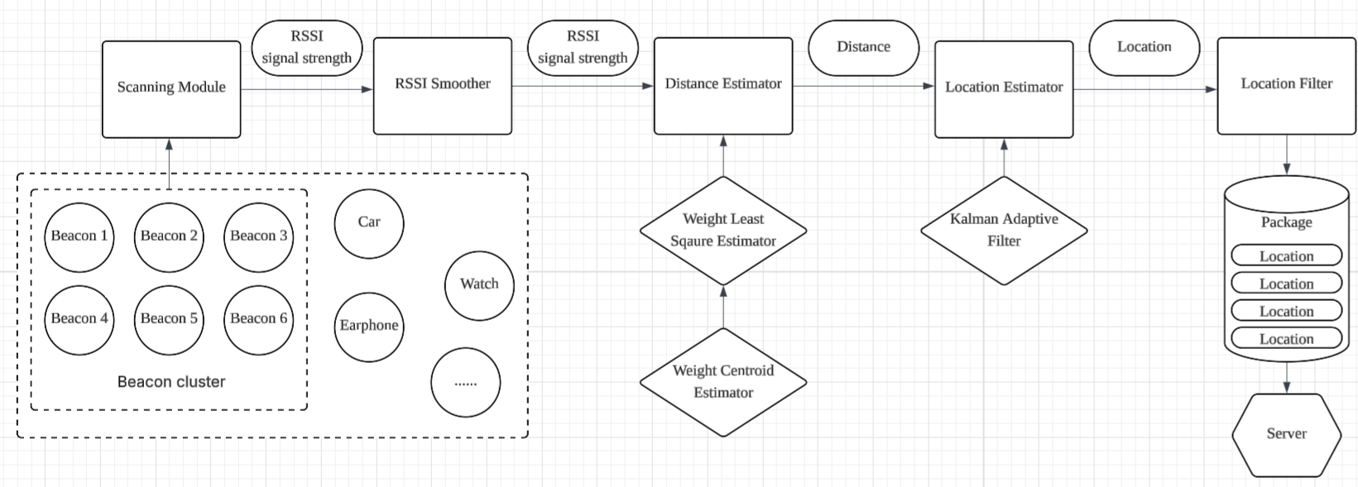
1. Mobile Prototype Application
Use BLT beacons to locate

Slide 14
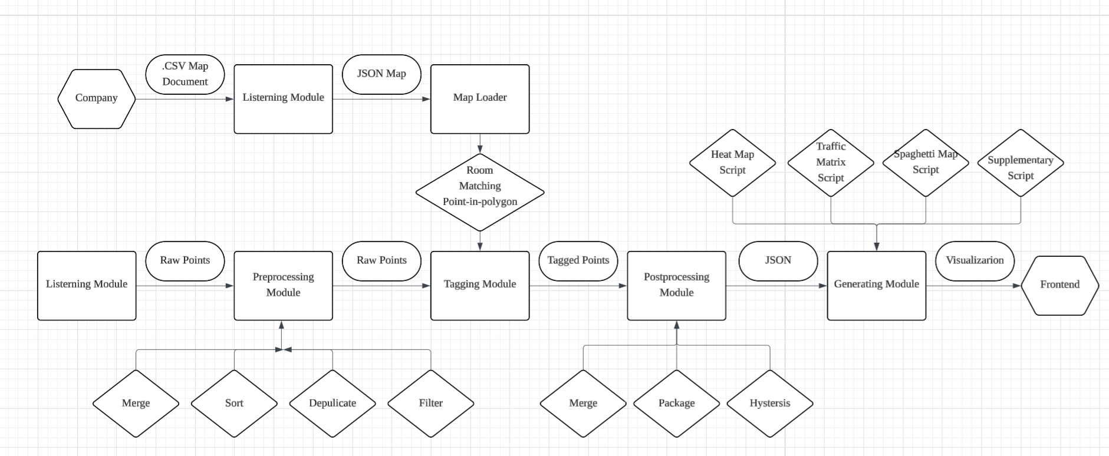
2. Backend Server

Slide 15
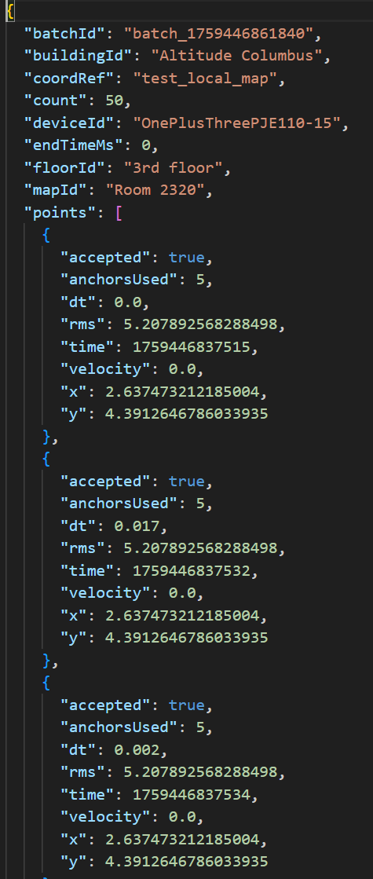
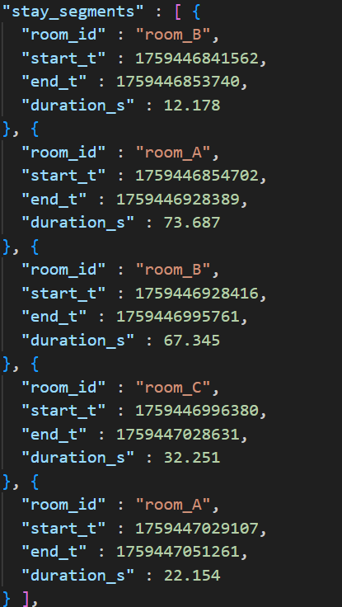
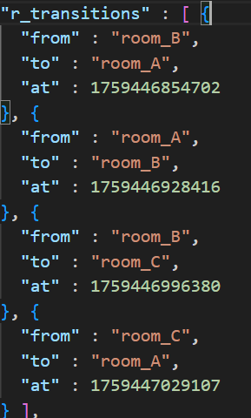
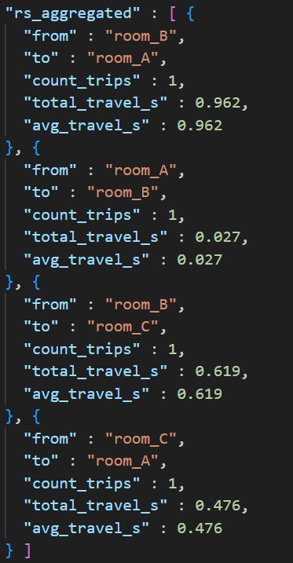
2. Backend Server
JSON file from Postprocessing module
Raw points from mobile

Slide 16
Future Plan
Before First Demo Day

Slide 17
Future Plan
After First Demo Day

Slide 18
Discussion

